Slide 1
CHERYL JOHNSON WORLD HEALTH ORGANIZATION HIV AND HEPATITIS DEPARTMENT 23 JULY 2018
Overview of importance and emerging innovations for testing and linkage

Slide 2
Progress toward the 90-90-90, 2015-2017
9.4 million people living with HIV (PLHIV) remain undiagnosed
59%
41%
Source: UNAIDS 2018

Slide 3
Progress toward the 90-90-90, 2015-2017
9.4 million people living with HIV (PLHIV) remain undiagnosed
59%
41%
Source: UNAIDS 2018

Slide 4
Many of those unreached are key populations
Proportion of key populations diagnosed and/or on treatment
compared to general populations, by country
83
75
65
61
61
71
60
54
50
53
49
51
40
10
Burkina Faso
Cote d’Ivoire
India
Malawi
Russia
South
Africa
South
Sudan
Togo
Zimbabwe
Mozambique
Special analysis using UNAIDS Global AIDS Monitoring data vs available key population data (data published in peer reviewed journals and IBBS) matched for year

Slide 5
Many of those unreached are young people
In 2017 there were 1.8 Million new HIV infections in people
37% were among 15-24 year olds – most in southern Africa
# New infections
People 15+
# New infections
Young People
Majority of new HIV infections among young men, compared to women, outside Africa
Source: WHO/UNAIDS 2018

Slide 6
How will we close this gap?
Diagnose the 25% of PLHIV who dont know their status
Link the 20% of PLHIV diagnosed who are not on ART
Link HIV-negatives to effective prevention to stay negative!
Photo Credit: http://fr.ubergizmo.com/2013/02/15/wifi-gratuit-metro-londonien-fin.html

Slide 7
Time to innovate for 2030!

Slide 8
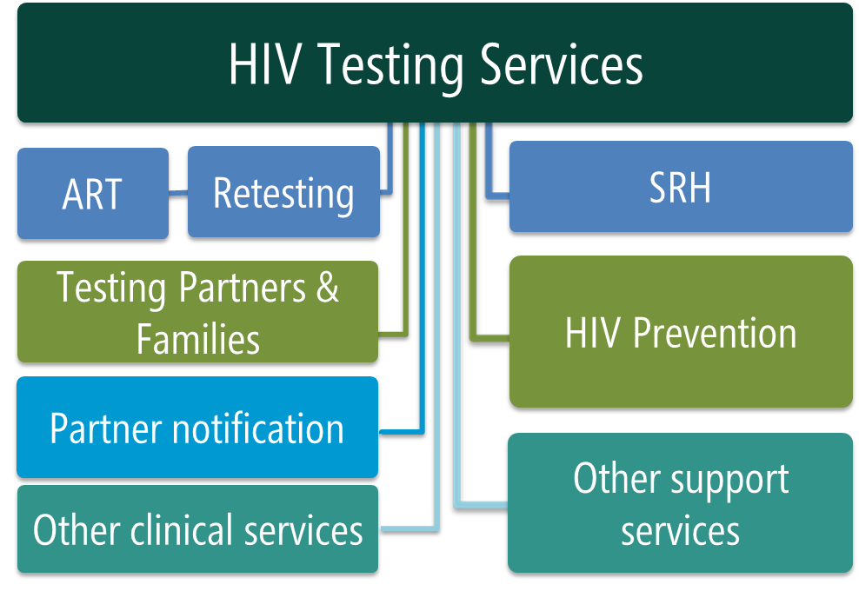
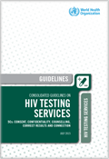
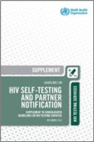
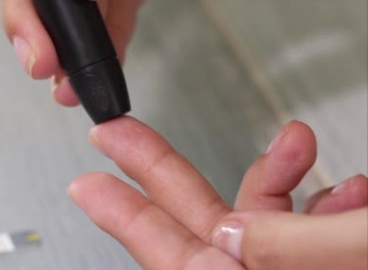
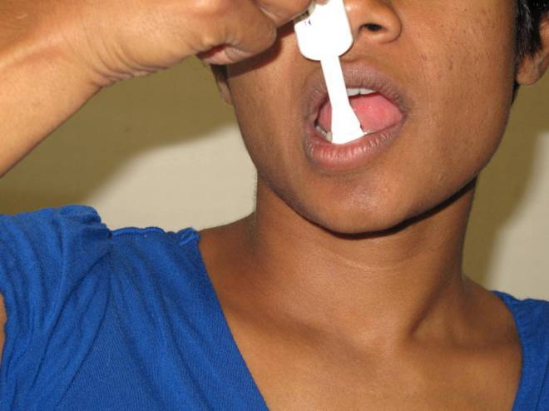
Recommended HIV Testing Services
Important gateway to treatment and prevention for individuals, couples, partners and families
Facility-based: Offering HIV testing in a facility, e.g. VCT, in-patient and out-patient clinics, ANC, TB, STI.
Community-based: Offering HIV testing in natural setting of the community, e.g. outreach, CBOs, workplace, clubs, bars.
Assisted partner notification: Assisting individuals with HIV by contacting their sexual and/or drug injecting partners and offering them HIV testing services.
HIV self-testing: Offering self-test kit for individual, and/or their partner, enabling them to collect their sample (oral or blood), perform test, and interpret results in private. All reactive results need confirmation.
Source: WHO 2015; WHO 2016
Notes:
HIV testing is an important gateway to treatment and prevention.
Following an HIV test:
Those who test negative can be linked to effective HIV methods, e.g. voluntary male medical circumcision, pre exposure prophylaxis, harm reduction and condoms
Those who test positive can be linked to lifesaving treatment
There are many different approaches: In facility settings, community-settings or through self-testing

Slide 9
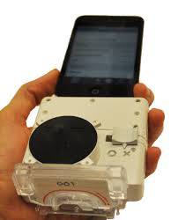
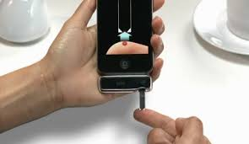
Innovate with technologies
HIV self-testing
Mulidisease testing at point-of-care
Syphilis, HCV - including multiplex with HIV
Apps and social networks
Readers and Devices
WHO ongoing review found integrating multi-disease testing (especially STIs) in community-based HIV testing increased testing uptake (median=87.5%; IQR=61-96%) than in those that did not (median=76.0%; IQR =60-89%). Source: Mathews et al 2015

Slide 10
Innovate with service delivery Differentiated HIV testing services
It’s time to test differently launched at AIDS 2018
Go to: http://www.differentiatedcare.org/

Slide 11
Time to innovate for 2030!

Slide 12
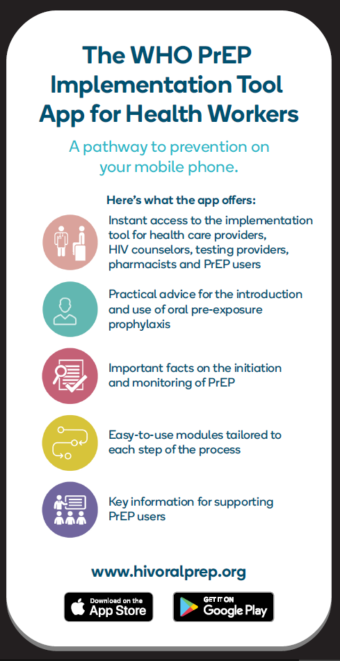
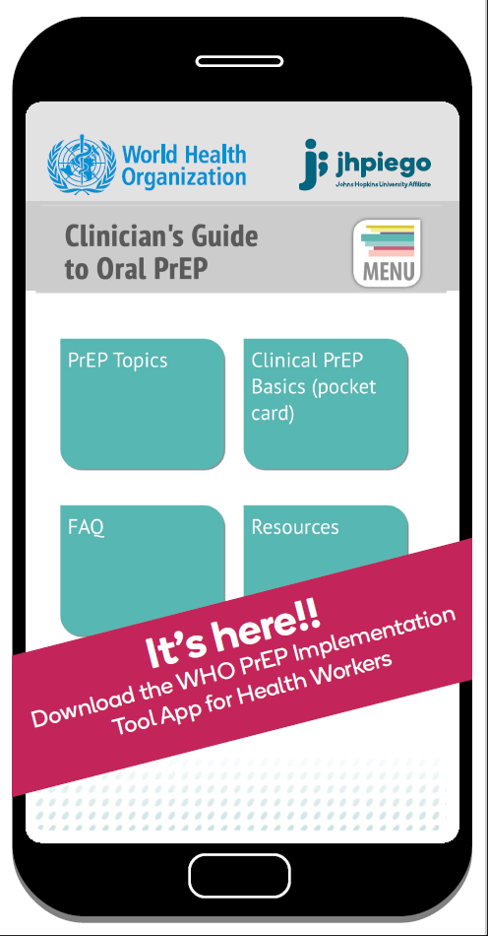
WHO is innovating too!
Search “WHO PrEP” and “WHO HTS Info”
In Google Play or App Store
Available online or offline – everywhere!
Download then share!

